Slide 1
Partner presentations with special emphasis on their HE research potential and
practices, as well as role in SWARM
Emina Hadžić
University of Sarajevo
Kick-off/ Thursday, 20th December 2018, Niš
This project has been funded with support from the European Commission. This publication reflects the views only of the author, and the Commission cannot be held responsible for any use which may be made of the information contained therein.

Slide 2
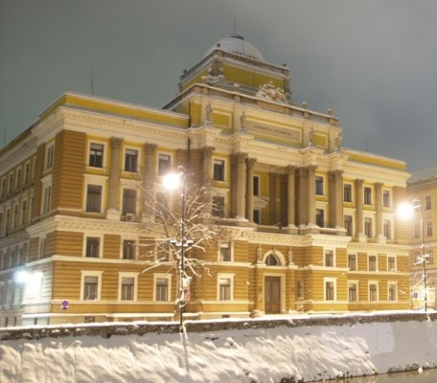
History of University
Sarajevo was first placed on the map of academic centres in this part of Europe in 1573, with the signing of the Waqfname (Book of Endowment) by Gazi Husrev-bey. Today, Gazi Husrev-bey’s Library is, as an associate member, the oldest institution within the University of Sarajevo.
Strengthening of master curricula in water resources management
for the Western Balkans HEIs and stakeholders
www.swarm.ni.ac.rs

Slide 3
The Faculty of Agriculture and Forestry was established in 1940, followed by the Faculty of Medicine in 1944. The Teacher Training College and the Institute of Biology were established in Sarajevo after the end of World War II. Following the establishment of the Faculties of Medicine, Law and Agriculture and Forestry and the subsequent establishment of the Technical Faculty, the Assembly of the People’s Republic of Bosnia and Herzegovina adopted the Law on University in 1949, which formally established the University of Sarajevo. The Faculty of Philosophy (with a science department) and the Faculty of Veterinary Medicine became its members in 1950. Decades that followed saw a period of intense growth.
History of University
Strengthening of master curricula in water resources management
for the Western Balkans HEIs and stakeholders
www.swarm.ni.ac.rs

Slide 4
Until 1975, the University of Sarajevo was the only university in Bosnia and Herzegovina and the beacon of development of higher education and science in the country. It also contributed significantly to the establishment of the University of Banja Luka in 1975, the University of Tuzla in 1976 and the University of Mostar in 1977.
History of University
Strengthening of master curricula in water resources management
for the Western Balkans HEIs and stakeholders
www.swarm.ni.ac.rs

Slide 5
Understanding the importance of positioning itself within the European Higher Education Area (EHEA), the University of Sarajevo entered the complex process of reform in compliance with the Bologna principles in the 2005/2006 academic year without any state-level guidance and without any political, legal or financial support. The University has developed or participated in several international third-cycle programmes in line with EHEA-ERA standards. - undargraduated - master - doctoral
Strengthening of master curricula in water resources management
for the Western Balkans HEIs and stakeholders
www.swarm.ni.ac.rs

Slide 6
University in figures
>550
study programs,
of which 185 master programs and
93 doctoral programs
1.795 employees
55.000 students attend currently
UNTIL NOW:
130.000 students graduated,
4000 candidates obtained M.Sc. degree
2300 candidates obtained Ph.D. in 43 different scientific field
Uni Sarajevo has established partnerships with more than 40 Universities from Europe, America, Asia, Africa.
5246
graduate students in 2018
886 FOREIGN STUDENTS
Strengthening of master curricula in water resources management
for the Western Balkans HEIs and stakeholders
www.swarm.ni.ac.rs

Slide 7
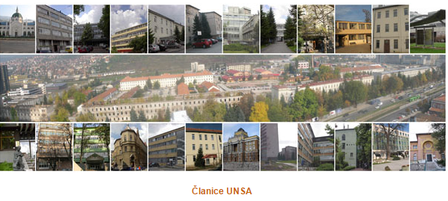
In terms of organization, the University of Sarajevo today is a large and complex public institution, comprising 30 organizational units: 22 Faculties, 3 Academies, and 5 research institutes, in six areas of academic work: social science, humanities, medicine, technical studies, science, bio-technology and art.
Associate members of the University include the National and University Library of BiH, Gazi Husrev-bey’s Library and the National Museum, as well as other units.

Slide 8
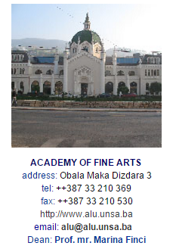
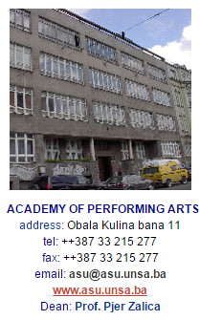
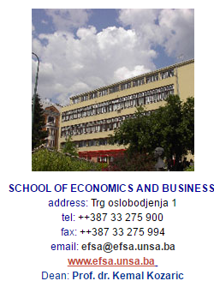
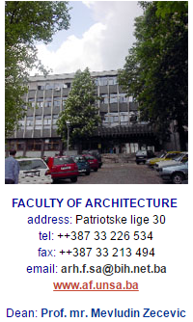
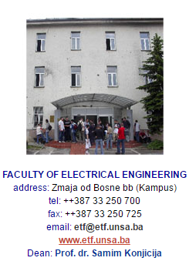
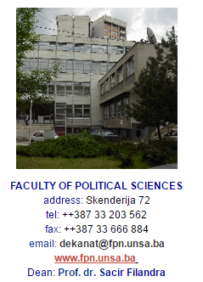
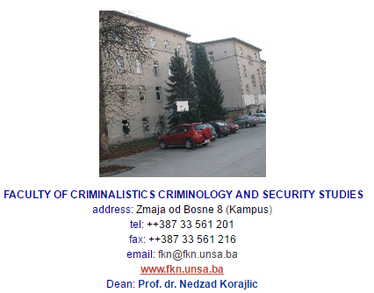

Slide 9
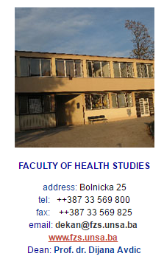
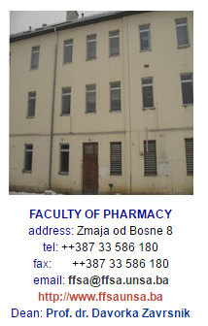
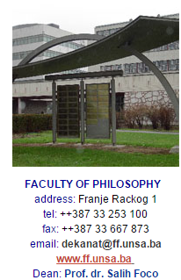
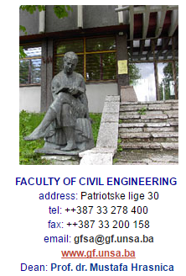
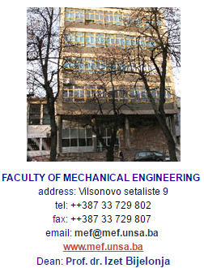
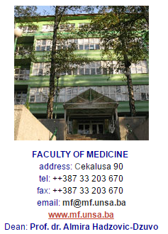
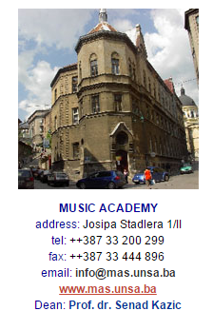

Slide 10
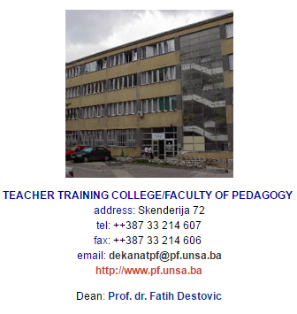
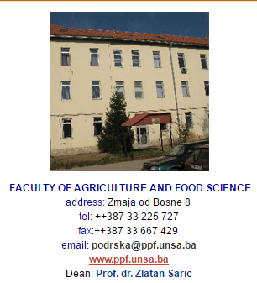
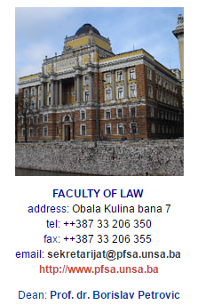
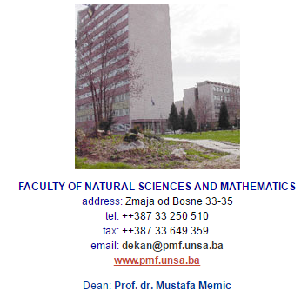
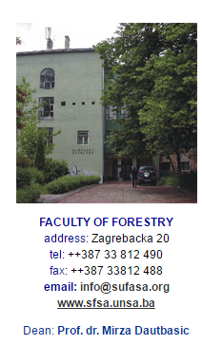

Slide 11
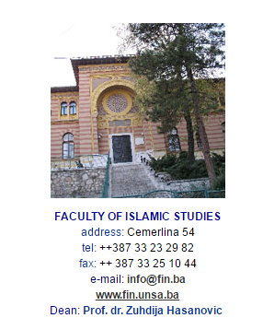
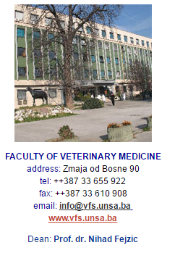
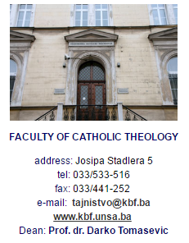

Slide 12
At the Faculty of Civil Engineering there is a Department of Water Resources and Environmental Engineering. Faculty of Civil Engineering - https:/www.gf.unsa.ba University of Sarajevo - https:/www.unsa.ba
Potential and practices, as well as role in SWARM
Strengthening of master curricula in water resources management
for the Western Balkans HEIs and stakeholders
www.swarm.ni.ac.rs

Slide 13
Thank you!!!
Strengthening of master curricula in water resources management
for the Western Balkans HEIs and stakeholders
www.swarm.ni.ac.rs

